Slide 1

Longitudinal Bio-Impedance Study in cognitive status
Lab Meeting
2025.11.07

Slide 2
General Overview and Feasibility of Group Options
Preprocessing
Multiple imputation for missing data (MICE/PMM) in SNSB domains by diagnosis group.
Exclude: Invalid/missing BIA/cognitive status data, age < 55, retain only valid cognitive groups (CN, MCI, AD).
Participants with ≥2 longitudinal visits (N=349)
 | AD | CN | MCI | Total
AD | 1 | 0 | 1 | 2
CN | 0 | 218 | 21 | 239
MCI | 7 | 42 | 59 | 108
Total | 8 | 260 | 81 | 349
Notes:
This week, I learned from R scripts provided by DieuNi and Joel. After that, I started Preprocessing with
Next, I started filtering for participants who had two or more longitudinal visits, resulting in a total of 349 participants.

Slide 3
General Overview and Feasibility of Group Options
Trajectory-Defined Groups:
Stable CN: 218
CN→MCI: 21
Stable MCI: 59
MCI→CN: 42
MCI→AD: 7
Stable AD: 1
AD→MCI: 1
+ intermediate converters (6 subjects)
Stable CN: 218
CN→MCI: 27
Excluded subjects with <11 months follow-up
Stable CN (CN→NC): 209 (89.3%)
Progressive CN (CN→MCI): 25 (10.7%)
Notes:
Below are the subgroups. I will begin with Stable CN (Cognitively Normal) and Progressive CN. However, the sample size for Progressive CN is quite small. Therefore, I'm including intermediate converters to add 6 subjects, increasing the current number to 27. I then filtered further by excluding subjects with less than 11 months of follow-up. The current total is 25.
I would like to ask the professor for an opinion on the 11-month filtering threshold. I believe that below this threshold, specifically, there are some subjects with a follow-up duration of 3 to 6 or 8 months. Is that cutoff appropriate?

Slide 4
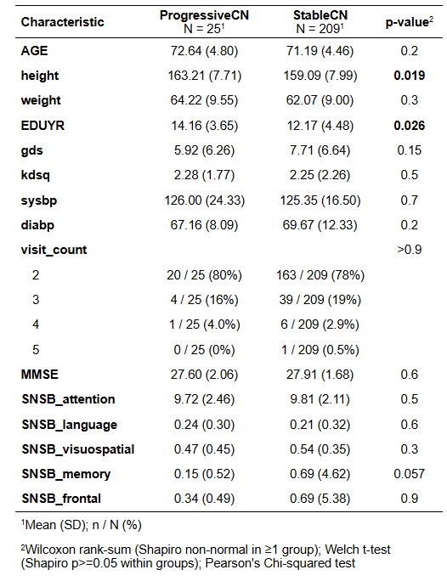
Table 1: Demographic at baseline
Notes:
Next, I proceeded to compare the two groups at baseline. I first performed the Shapiro test, and then selected either the t-test or the U-test for each continuous variable, and the Chi-squared test for the categorical variables.
The preliminary show statistically significant differences in height and years of education.

Slide 5
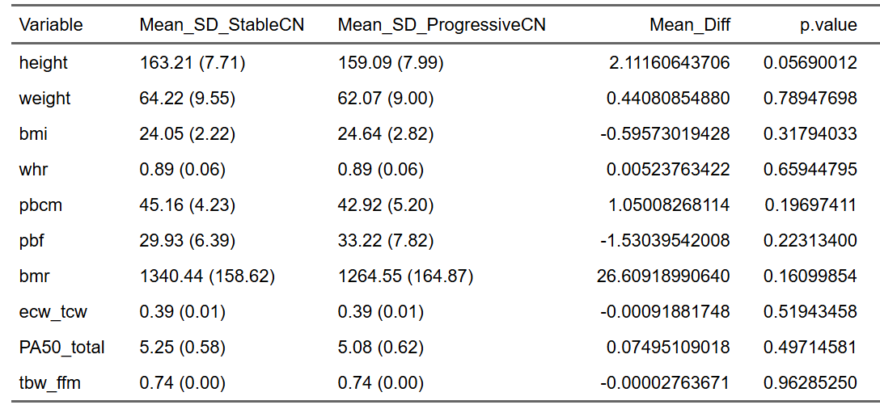
Table 2: Anthropometry and whole-body composition in 2 groups upon controlling for age, sex, education & GDS score in baseline.
Notes:
Next, I used ANCOVA to evaluate the BIA variables between the two groups upon controlling for age, sex, education & GDS score, as shown in Tables 2 and 3. Currently, the only baseline difference is observed in Water Lean (upper).

Slide 6
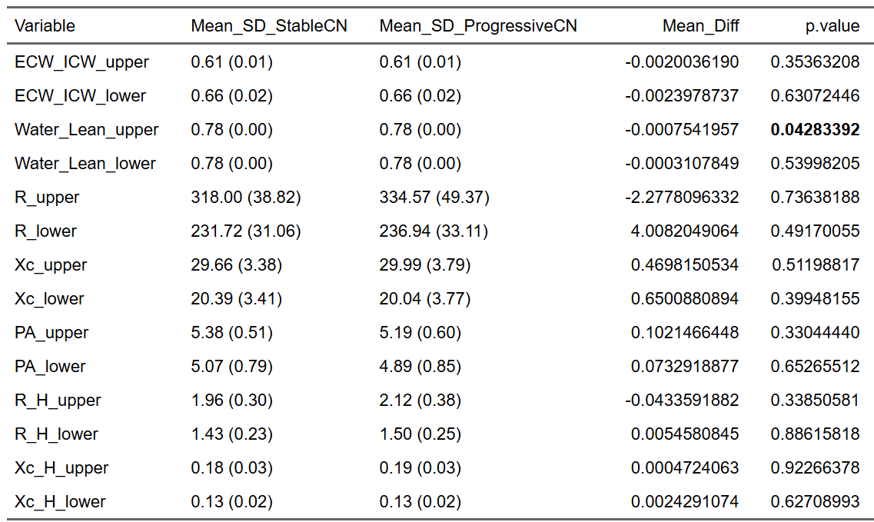
Table 3: Segmental bioimpedance variables in 2 groups upon
controlling for age, sex, education & GDS score in baseline

Slide 7
LINEAR MIXED EFFECTS (LME)
model <- lmer(SPR ~ elapsed_years*Change_Type + AGE + SEX + EDUYR + (1 + elapsed_years| USUBJID), data = data)
Notes:
Next week, I will continue the data analysis using Linear Mixed Effects (LME) models.

Slide 8
THANK YOU FOR YOUR ATTENTION

